Slide 1

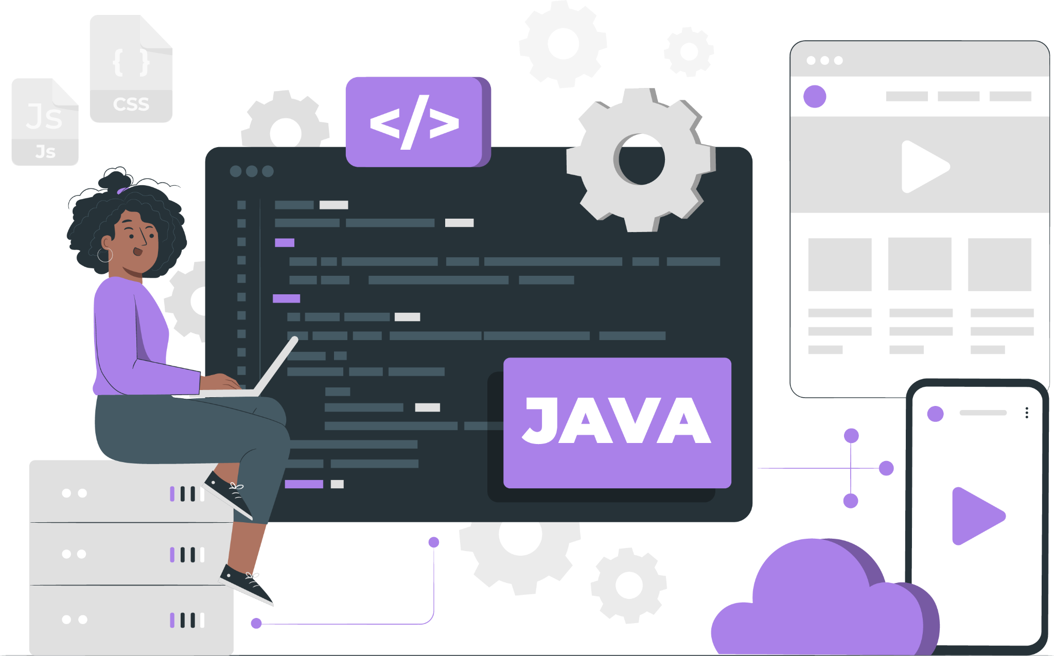
Lecture
Hibernate(ORM)

Slide 2
List of Concepts Involved:
Hibernate Introduction
Hibernate Architecture
Usage of API to perform persistence operation
Usage of Caching and Connection pooling in Hibernate

Slide 3
When we already have JDBC technology, why do we need to go for Hibernate?
Limitations of JDBC

Slide 4
Hibernate Introduction
Database independent
Standalone applications and Enterprise Applications.
Annotations
HQL
Good transaction support.

Slide 5
ORM:
ORM stands for : Object Relational Mapping.
ORM says “Do not convert object data, do operations in OOPs. Format only”.

Slide 9
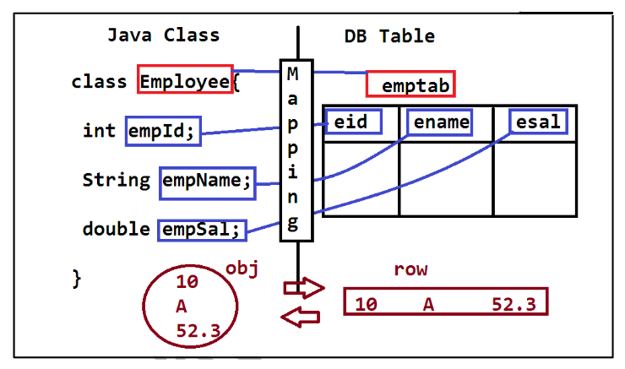
ORM:

Slide 10
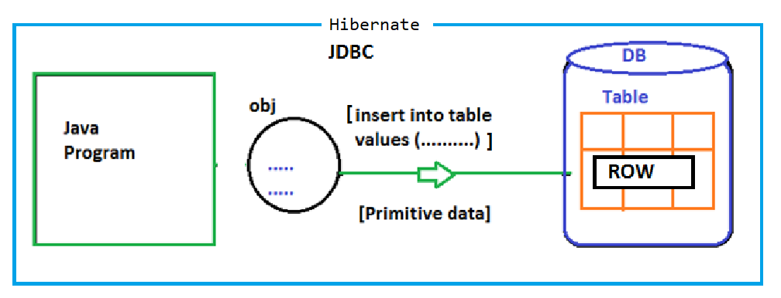
Hibernate Design

Slide 11
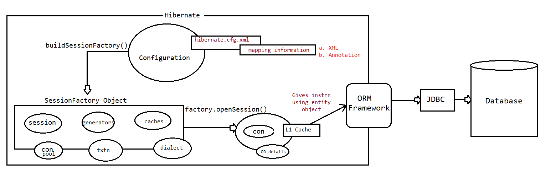
Hibernate Architecture

Slide 12
Steps to prepare Hibernate Application:
Prepare Persistence Class or Object.
Prepare Hibernate Configuration File
Prepare Hibernate Client Application
Perform Persistence Operations

Slide 13
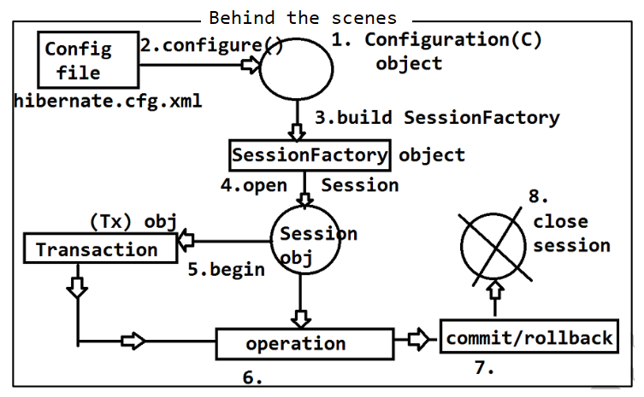
Perform Persistence Operations

Slide 14
Hibernate CRUD coding Examples
Link

Slide 15
Usage of API to perform persistence operation
When Client Application performs a persistence operation, Hibernate Software will perform the following actions.
Hibernate Software will take persistence method call and identify persistence Object.
Hibernate Software will take all mapping details from a hibernate mapping file like database table name and all column names on the basis of Persistence object.
Hibernate Software will prepare database dependent sql query on the basis of table names and column names and with the persistence object provided data.
Hibernate Software will execute the generated database dependent sql query and perform the required persistence operation.

Slide 16
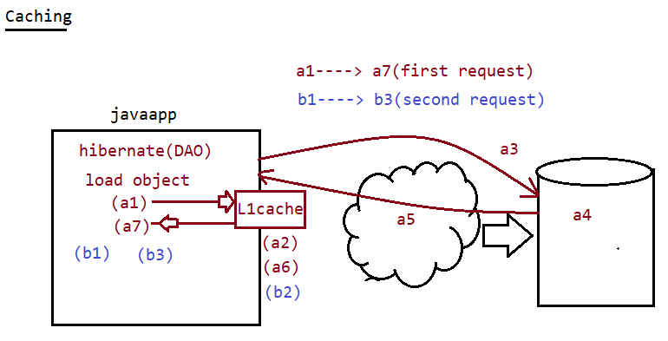
Caching

Slide 17
Next Lecture
Spring Core

Slide 18
THANK YOU

